Slide 1
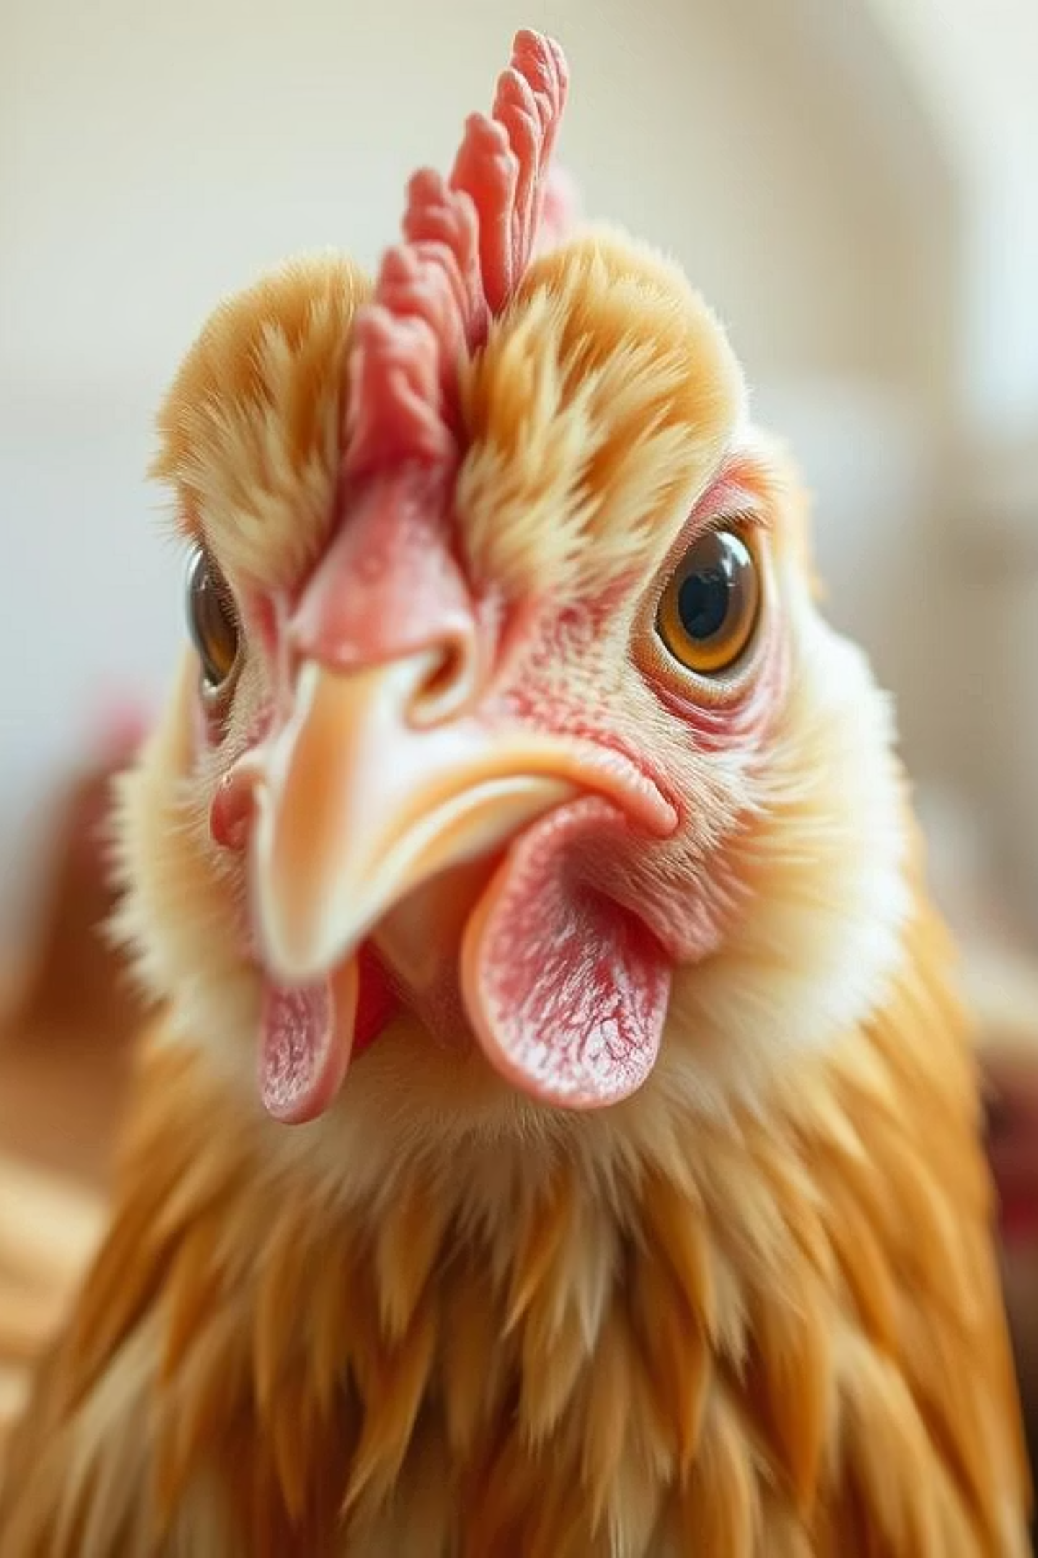
Transfer Learning for Poultry Disease Classification
Presented by K. Vaishnavi

Slide 2



The Challenge: Timely Poultry Disease Diagnosis
Delayed Diagnosis
Limited Vet Access
Economic Impact
Farmers struggle with identifying poultry diseases promptly.
Remote areas face challenges in accessing veterinary services.
Delayed diagnosis leads to significant financial losses and disease spread.

Slide 3
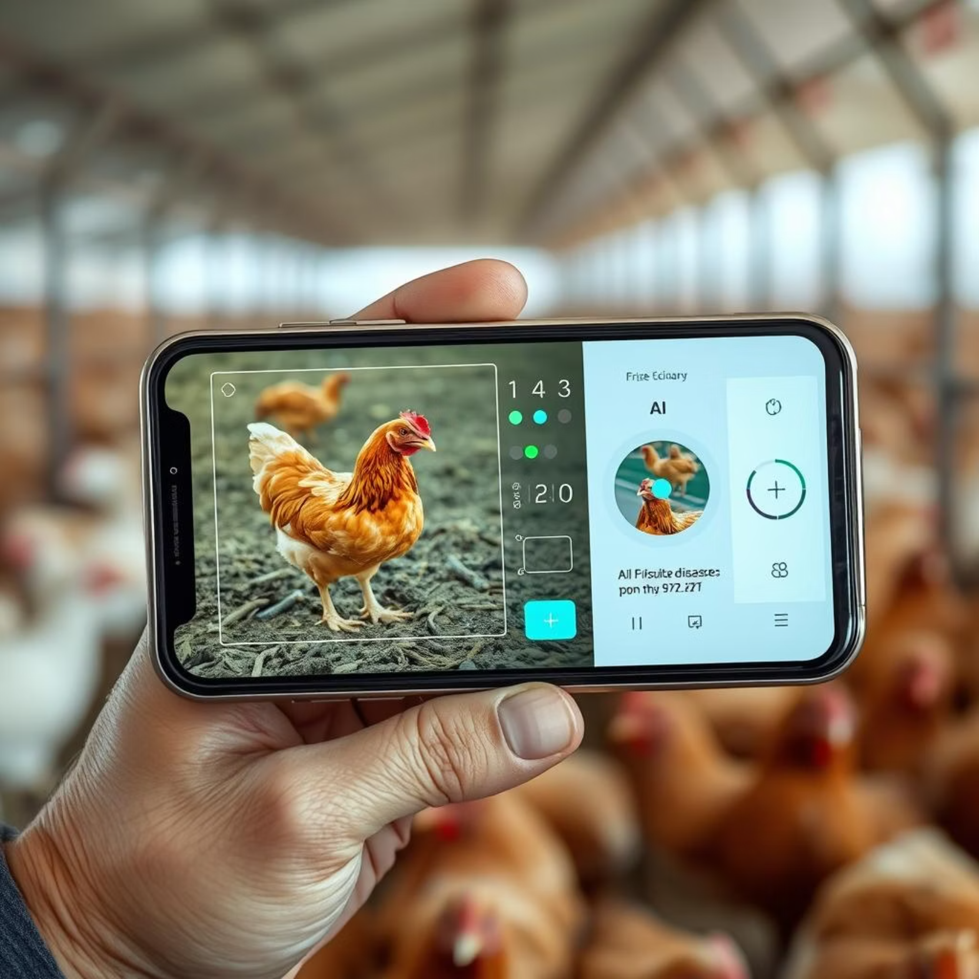
Our Solution: AI-Powered Mobile Diagnosis
An AI-based mobile application leveraging transfer learning for rapid disease classification.
Users upload images or input symptoms.
System predicts disease with treatment suggestions.

Slide 4
Key Disease Categories
Salmonella
Newcastle Disease
Symptoms: Diarrhea, weakness.
Symptoms: Respiratory issues, tremors.
Impact: High mortality rates.
Impact: Drop in egg production.
Coccidiosis
Healthy
Symptoms: Bloody droppings, weight loss, lethargy.
No disease indicators present.
Impact: Severe growth retardation.

Slide 5



Real-World Applications
Rural Outbreak
Commercial Farm
Veterinary Education
Farmer inputs symptoms, AI detects Coccidiosis. Swift action prevents widespread loss.
Daily checks identify early Newcastle Disease. Section quarantined, preventing major outbreak.
Students use app for simulated diagnosis, learning disease features and treatment hands-on.

Slide 6
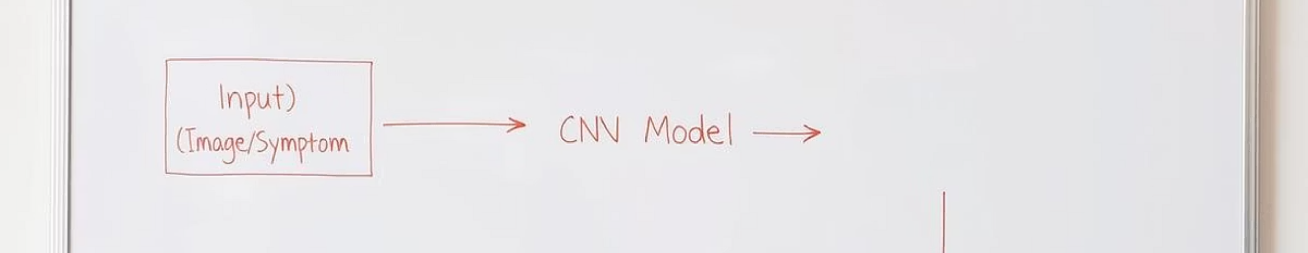
System Architecture
The core components of the poultry disease classification system.
Backend:
Frontend:
Model:
Flask for API handling.
HTML + CSS for user interface.
Transfer learning (CNN) for classification.

Slide 7
Performance Metrics
The accuracy of our AI model during various stages of development.
98.2%
94.6%
95.3%
Training Accuracy
Validation Accuracy
Fine-Tuned Accuracy
High precision during model training.
Strong performance on unseen data.
Improved accuracy after fine-tuning.
These results demonstrate the robust diagnostic capability of the system.

Slide 8
Benefits & Future Enhancements
Benefits
Future Enhancements
✅ Faster disease diagnosis
Expand disease categories
✅ Farmer empowerment and education
Develop Android/iOS versions
Implement voice-based input/output
Limitations
Include dosage recommendations
⚠️ Limited to trained diseases
Add multilingual support
⚠️ Requires quality images for accuracy

Slide 9
THANK YOU

